Slide 1
Fast StartUp Bootcamp
Dr. Demetris Gerogiannis
GreenTechChallenge Organizing Committee

Slide 2
I have an idea!

Slide 3
The reality…

Slide 4
I. Business Model Canvas

Slide 5
Let’s make thinks simple…
€ OUT
€ IN

Slide 6
Validation of business idea…
The owl mother believes her babies are the prettiest! (Aesop’s Myth)

Slide 7
II. Value Proposition Canvas

Slide 8
Deus Ex machina…
VALUE
PROPOSITION
CANVAS

Slide 9
Why is the Value Proposition Important?
72% of products fail to deliver value*
The viability of a company relies on how strong the Value Proposition is!
* Source: Simon-Kucher & Partners, 2014

Slide 10
The Value Proposition Canvas

Slide 11
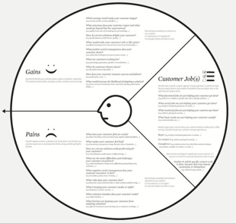
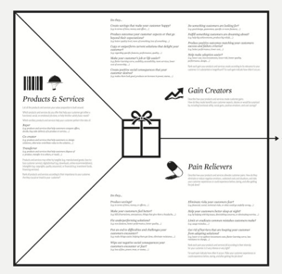
The Value Proposition Canvas
The Client (Customer Profile – Persona)
Activities/Tasks
Pains
Gains
The Value Proposition (Value map)
The Product/Service
Pain Relievers
Gain Creators

Slide 12
Example (VPC)
Business Idea: Coffee Delivery to Students
Student:
Task: Drink Coffee in the morning
Pain: Need to get up, dress up, go to the closest coffee shop
Gain: Wake up!!!
The Value Proposition:
Service: Mobile App
Pain Reliver: No need to move from my bed
Gain Creator: I have my coffee delivered!

Slide 13
BMC + VPC
Financial Projections
Pitch Deck
Market Research

Slide 14
III. Financial Projections

Slide 15
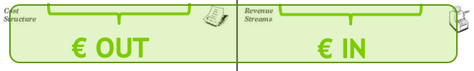
Is our venture viable?
Assumptions based on market research
Income – Expenses
Projections over coming years (at least 18 months)
OUT
IN

Slide 16
Revenue Streams
Typical models:
Subscription
License Fee
Commission
Mixed

Slide 17
Cost Structure
Typical costs
Initial Costs (CAPEX)
Operational Costs (OPEX)
Human Resources
Unit Costs
SMS/Email/Push Notifications…
Plastic Membership Card
Marketing (Ads…)
Fixed Costs

Slide 18
CAPEX (Typical Costs)
Company setup
Platform development
Physical structures
Legal
Patents
Certifications

Slide 19
OPEX (Typical Costs)
Rent
Utilities
Marketing
Licenses
Outsourcing contracts
Infrastructure (digital / Physical)
…

Slide 20
How much do we sell?
Profit
OUT
IN

Slide 21
Financial Projections
Costs
Market Research → Estimate sales / year

Slide 22
IV. Pitch Deck

Slide 23
What is a pitch deck?
Short
Comprehensive
Understandable
presentation of your business plan

Slide 24
Why do we pitch?
CONVINCE about venture profitability
Investor
Evaluator
Co-Founder
Achieve a GOAL
Funding
Award
Partnership

Slide 25
Profitability behind the scene… (I)
Problem/Solution
Real Problem?
Value Proposition is Strong or Loose?
Feasibility of the Solution
➔ What we do? – Pain/Gain

Slide 26
Profitability behind the scene… (II)
Market & Competition
Small or a big market?
Local or global? Scale up?
Red Ocean vs Blue Ocean?
Our competitive advantage?
➔ There is room to play

Slide 27
Profitability behind the scene… (III)
Teamwork!!!!
If you wish to go fast go alone… if you wish to go further go together
Multidisciplinary skills
Roles
➔ Capability to RUN THE BUSINESS!!!

Slide 28
Profitability behind the scene… (IV)
Financial projections
Sales plan (quantify)
Income – Expenses – Profit
➔ Does the business sound viable?

Slide 29
Goal achievement…
What we need?
Clear definition of the needs
How are we going to achieve it?
Execution Plan
Milestones
Proposition
What’s in it for the other side?
➔ I need this… To do that… And I offer that…

Slide 30
To sum up
A pitch deck must be:
exact – brief – understandable
to convince about
The viability of the business
And the capability of the team
Now is the time and we can do it
And state a clear offer
There is a gain for the listening side
Dynamic and adjustable to goals
Reflects current situation and needs = goals

Slide 31
Navigation tips…
business
Iidea
Fast! Fast! Fast!

Slide 32
Thank You!
Dr. Demetris Gerogiannis
GreenTechChallenge Organizing Committee

